Slide 1
A Simple Methodology to Evaluate the Disproportionate Impacts of Fare and Service Changes on Protected Populations in a Fixed Guide-way System By Vijay Mahal HDR Engineering May 11, 2011 13th TRB Applications Conference Reno

Slide 2
Presentation Purpose
Objectives:
Define the problem / Explain equity impacts
Review existing methods
Discuss HDR method
Present an example

Slide 3
The Problem
Public transportation is
A public service
Most often uses Federal funds
Service and Fare changes impacts people
Are protected populations impacted disproportionately?
If so, mitigation is required

Slide 4
Equity Impacts: Title VI requirements
What is “Title VI Requirements” ?
Who needs to comply ?
When is it required ?
Why is it required ?

Slide 5
Fare and Service Changes
Fare:
Across the board increase
Increase on minimum fares only
Increase on some selected modes only
Increase in transfer fares
Service:
Route modifications
Service reductions
Service elimination

Slide 6
How do you measure impacts?
Using travel models
Surveys
Simple sketch planning techniques
Note: FTA does not endorse any
particular method

Slide 7
HDR’s Methodology
Developed in 2010 for a fixed guide-way system.
First applied to BART.
It is a Sketch planning approach.
Does not require large data.
Easy to understand (most FTA reviewers are not modelers)

Slide 8
HDR’s Methodology
Six steps involved
Step 1: Identify where protected populations live (in GIS)
Step 2: Delineate station catchment area. Estimate average boarding fares at each station before and after fare increase
Step 3: Determine magnitude of protected populations in the station catchment area

Slide 9
HDR’s Methodology
Step 4: Compute system wide average fare for each protected group (before & after)
Step 5: Compare % increase in fares for protected groups with non-protected groups
Step 6: Use professional judgment or statistical tests to determine if disparity exists

Slide 10
Example
Ex: Lagrange County Transportation Authority (LCTA)
LCTA wants to increase rail fares by 10 %. CBD surcharge by 5 %.
System has distance based fare
Question: Will there be any disproportionate impacts associated with this fare increase ?

Slide 11
Data needed
Fare tables
Station to station passenger flows (if available)
Census Data / ACS Data
Catchment area definition

Slide 12
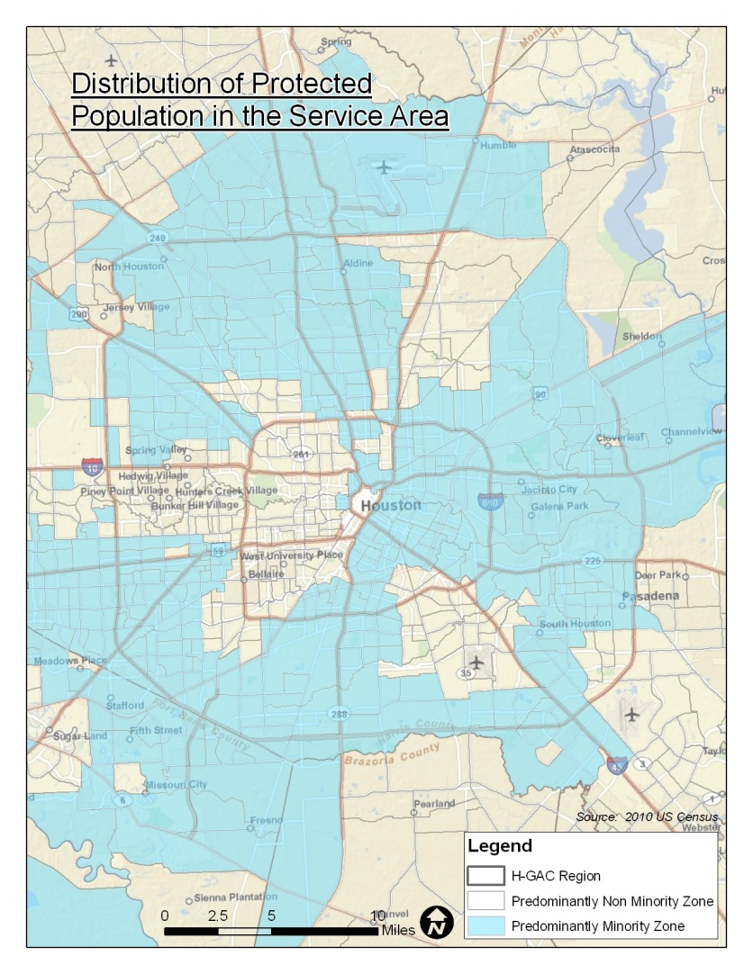
Step 1: Identify Protected Groups
Map the Distribution of minority, non-minority, low-income and non-low-income populations.
Definitions must be consistent with MPO’s standards

Slide 13
Step 2: Delineate catchment Area / Estimate Ave. fares
Delineate catchment area
Use data from survey
Or 1/3 mile for rail
Or 1/4 mile for Bus
Estimate average boarding fares for each station
Simple average
Average weighted by trips

Slide 14
Step 2: Estimate Average Boarding Fares

Slide 15
Step 2: Estimate Average Boarding Fares

Slide 16
Step 2: Estimate Average Boarding Fares

Slide 17
Step 2: Estimate Average Boarding Fares

Slide 18
Average boarding fares
Sycamore Ctr:
Ave. Boarding Fare: $ 3.35
(before fare increase)
What does it represent?

Slide 19
Percent increase in boarding fares
Sycamore Ctr:
Ave. Boarding Fare: $ 3.73
(after fare increase)
Fare Increase: 11.40 % for all people in the catchment area

Slide 20
Percent increase in boarding fares
Percent increase is a function of:
Trip flows
Increase in min. boarding fee
Increase in CBD surcharge

Slide 21
Fare Increase for the System
Simple average
Average weighted by population
Average weighted by protected population

Slide 22
Step 3: Estimate the magnitude of Protected Populations
US Census, ACS
Dealing with Overlapping areas

Slide 23
Step 4: Compute System wide Average Fare

Slide 24
Step 5: Compare Percentages
Ave. fare for Minorities: 12.96%
Ave. fare for Non-minorities: 12.67%
Ave. fare for Low-income pop: 12.31%
Ave. fare for Non-low-inc pop: 12.01%

Slide 25
Step 6: Determination of Disparate Impact
Use professional judgment
Use statistical methods

Slide 26
Closing Remarks
HDR method is
Simple and logical
Doesn’t require large data
Can be expanded to any system
Acceptable to FTA

